Slide 1

Image Processing in Robotic Simulation
Robo Carnival 2023

Slide 2
Remote API
CoppeliaSim has support for web-socket based remote APIs for Python, MATLAB, C/C++, Java, Octave
We can use remote APIs to run external code scripts to control robots via these languages
This is useful because Python has rich libraries for planning, computer vision and machine learning / deep learning
In this part, we will see the use of OpenCV in Python for making a vision based robot that will be able to play soccer.

Slide 3
Using Python Remote API
Python remote API documentation is a mandatory reference for us to find the necessary functions: https://www.coppeliarobotics.com/helpFiles/en/remoteApiFunctionsPython.htm
We need to copy some files to the source directory of the python script/notebook
C:\Program Files\CoppeliaRobotics\CoppeliaSimEdu\programming\legacyRemoteApi\remoteApiBindings\lib\lib\Windows\remoteApi.dll
C:\Program Files\CoppeliaRobotics\CoppeliaSimEdu\programming\legacyRemoteApi\remoteApiBindings\python\python\sim.py
C:\Program Files\CoppeliaRobotics\CoppeliaSimEdu\programming\legacyRemoteApi\remoteApiBindings\python\python\simConst.py

Slide 4
Vision Sensor Functions
returnCode, resolution, image = simxGetVisionSensorImage(clientID, sensorHandle, options, operationMode)
- This function will return the actual image sent by the sensor. Useful for full resolution images.
- resolution is an array containing the resolution of the returned image as set in the simulation
- image is an array object that will contain the image data
- options for receiving image, grayscale/RGB
- operationMode: for the first time this function is called, it should be set in streaming mode to let the simulator know that we will be receiving stream of information. For the consecutive calls, it should be buffer mode.

Slide 5
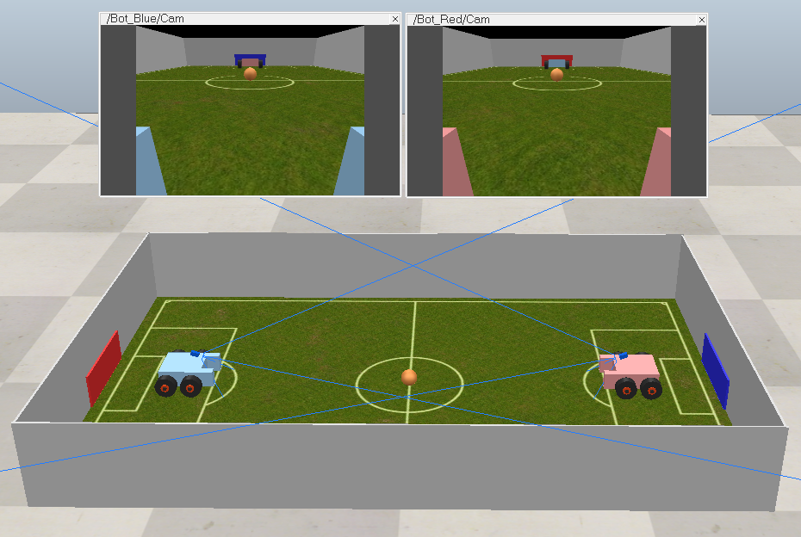
Soccer Bot

Slide 6
Getting Images from Robot
During initialization, simxGetVisionSensorImage() has to be called with “streaming” option once:
err, res, image = sim.simxGetVisionSensorImage(clientID, camHandle, 0, sim.simx_opmode_streaming)
0 for color image
1 for grayscale

Slide 7
Getting Images from Robot
During loop, simxGetVisionSensorImage() has to be called with “buffer” option:
err, res, image_raw = sim.simxGetVisionSensorImage(clientID, camHandle, 0, sim.simx_opmode_buffer)
The raw image data is an unpacked array of pixel values in the red, green and blue channels.
Resolution is a list of image dimensions (width, height)
We need to reshape the unpacked array into the dimensions to get a proper image.
img = np.array(image_raw, dtype=np.uint8) ➔ data type conversion
img.resize([res[1], res[0], 3]) ➔ reshaping array
img = img[::-1,:, :] ➔ flip

Slide 8
Head Over to the Code!
Soccerbot.ipynb notebook contains the code for soccer bots in soccerbot.ttt
ImageProcessing.ipynb notebook contains the code for image processing tutorial
To open the notebook:
Open the command line (cmd.exe - windows)/ terminal window (linux) in the notebook directory
Activate the conda environment by typing “conda activate env_name”
Start jupyter notebook by typing “jupyter notebook”
If you do not wish to use jupyter notebook, you can open the notebook in any other software (visual studio code/PyCharm) and copy the code to a .py file first.
Run the simulation first, and then run the python notebook / script to take control of the robot inside the simulation.

Slide 9
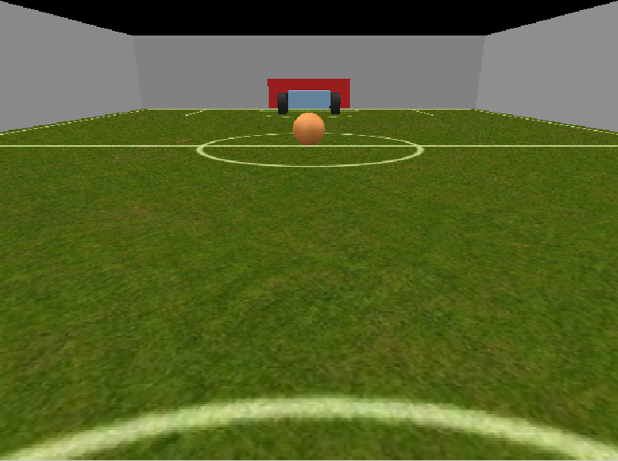
Through the Eyes of a Robot

Slide 10
Detecting Goal-post and Ball
The red robot can see an orange ball and a red goal-post through the camera
We need to detect the ball first
Then we need to detect the goal-post
Finally, we need to push the ball towards the goal-post

Slide 11
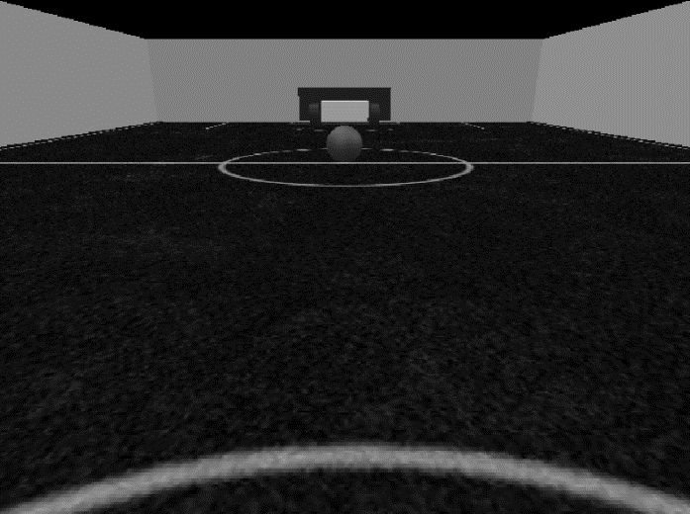
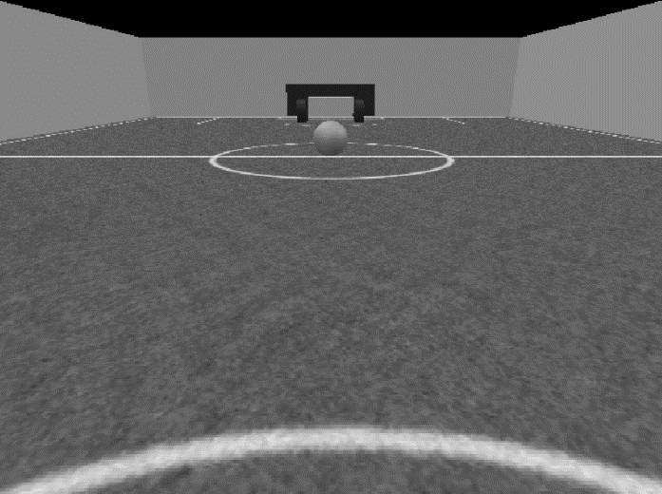
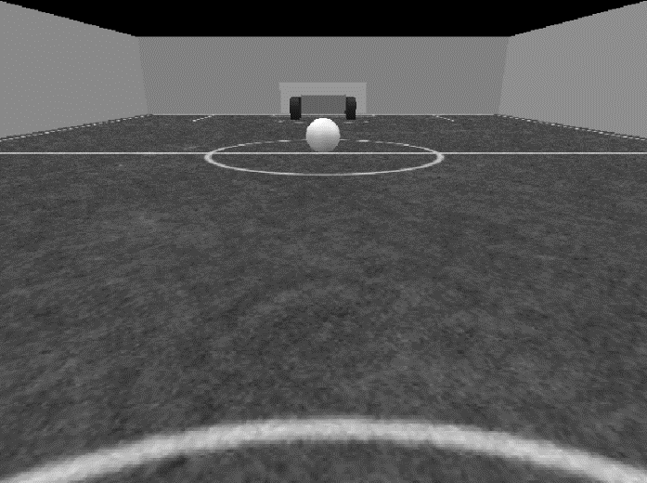
Color Channels
Height
Width
RGB images have 3 color channels – Red, Green and Blue
Images are represented as 3 layers of 2D arrays
In each channel, higher color intensity appears bright
Blue Channel
Green Channel
Red Channel

Slide 12
Color Channels
Blue opponent appears brighter in the blue image
The orange ball appears brighter in the red channel
White walls appear brighter in all 3 channels
Blue Channel
Green Channel
Red Channel

Slide 13
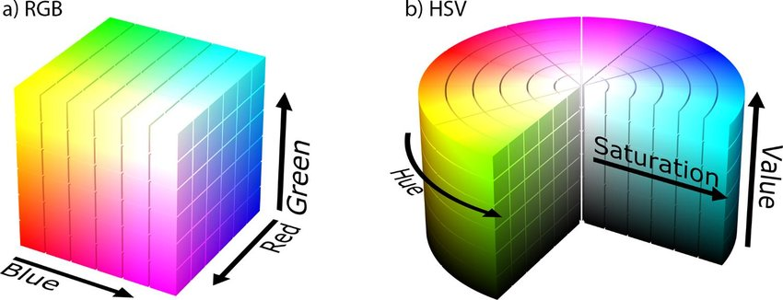
RGB and HSV space
RGB color channels are sensitive to image brightness (all three channels appear bright for white colors)
A better way to detect colors accurately regardless of illumination is the HSV color space.

Slide 14
Detecting Color with Hue
Each color has a specific range of Hue value for it
We can find colors by checking which pixels fall in the given hue range

Slide 15
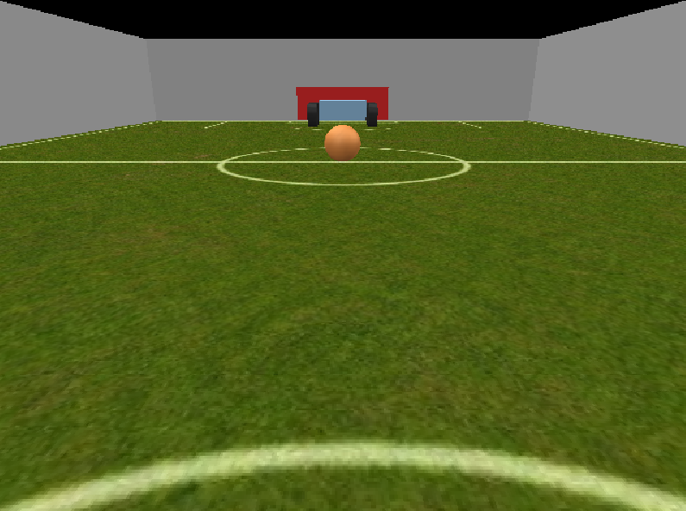
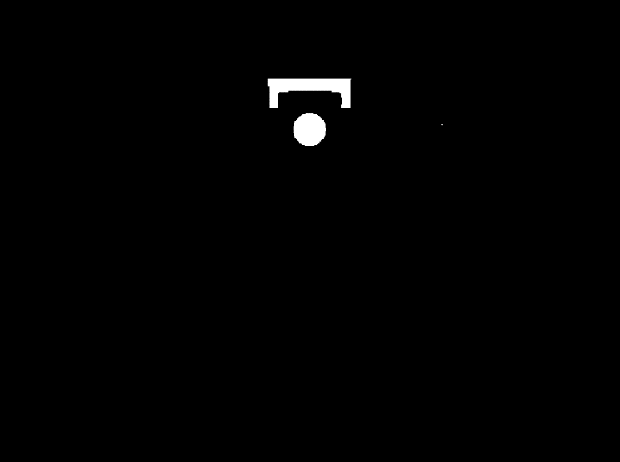
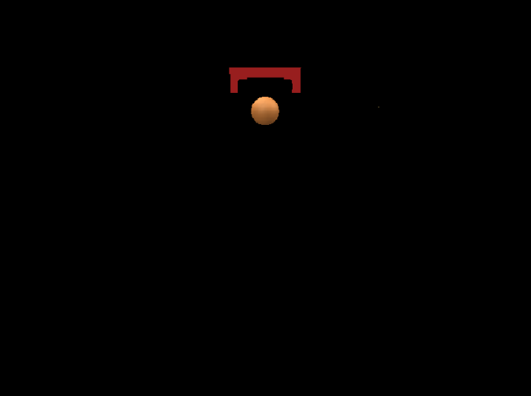
Detecting Color with Hue
We will find the parts in the image where
Hue = 0 to 20
Saturation = 10 to 255
Value = 10 to 255
This is created as a mask (Binary image)
Original Image
Green Channel
Red Channel

Slide 16
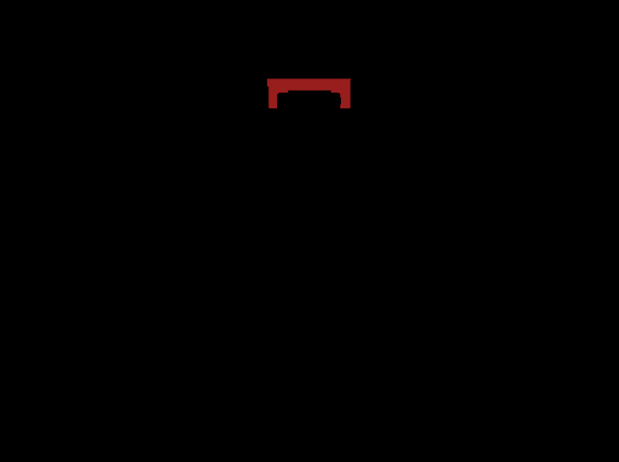
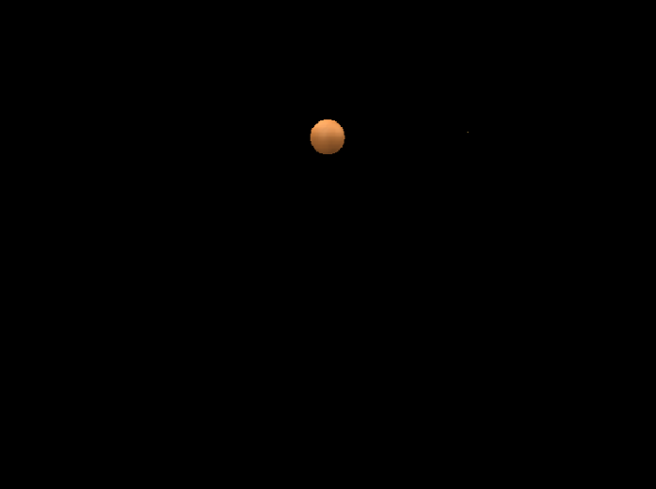
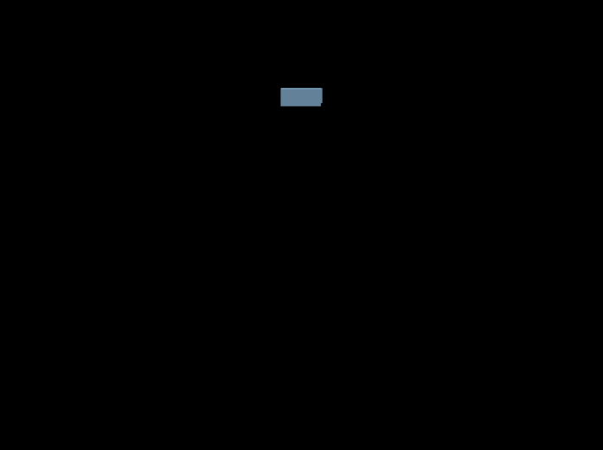
Detecting Color with Hue
For accurately finding the opposite goal post, opponent and the ball, some experiment is required
Goal Post Red = Hue: 0 to 5
Ball Orange = Hue: 5 to 20
Opponent Blue = Hue: 100 to 160
Goalpost
Ball
Opponent

Slide 17
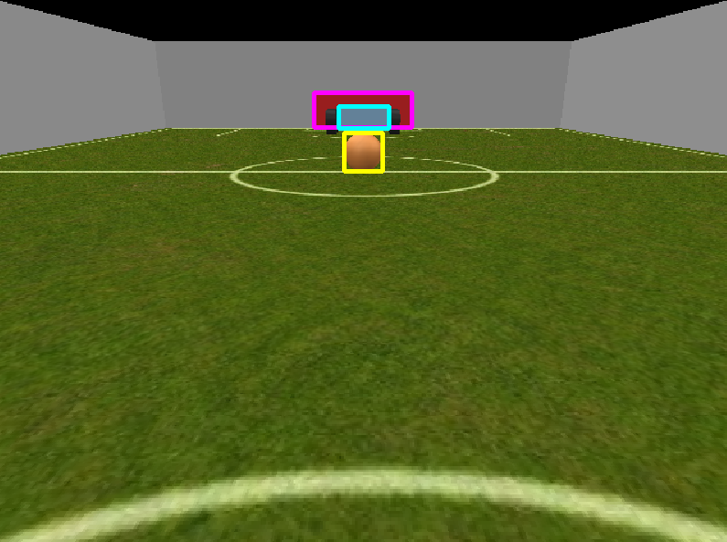
Detecting Contours
OpenCV has functions for detecting contours inside an image mask.
contours = cv2.findContours(mask, cv2.RETR_EXTERNAL, cv2.CHAIN_APPROX_SIMPLE)
Sometimes random small pixels can be detected. We apply denoising to remove them (morphological opening – next slide)
Applying this function on all three masks (goalpost, ball, opponent) – we can find out their corresponding boundingboxes – letting us know their locations in frame
Now that we can find all these, time to make our robot approach the ball

Slide 18





Mophological Transformations
Mask
Opening = Erosion ➔ Dilation
Erosion
Dilation
Closing = Dilation ➔ Erosion

Slide 19
Robot Control
The objective is to push the ball towards the goal-post
Robot can reach the ball by going forward while keeping it in the middle of the frame

Slide 20
Tracking the Ball
We will first rotate only left or right to track the ball
Tracking is done by rotating motors in opposite directions

Slide 21
Getting to the Ball
After tracking the ball, we will move towards it

Slide 22
Pushing Towards the Goal
When the ball, goalpost and the robot are in line, we can push it to the goal

